Slide 1
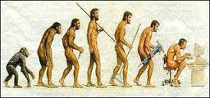
BCSE306L - Artificial Intelligence
INTRODUCTION

Slide 2
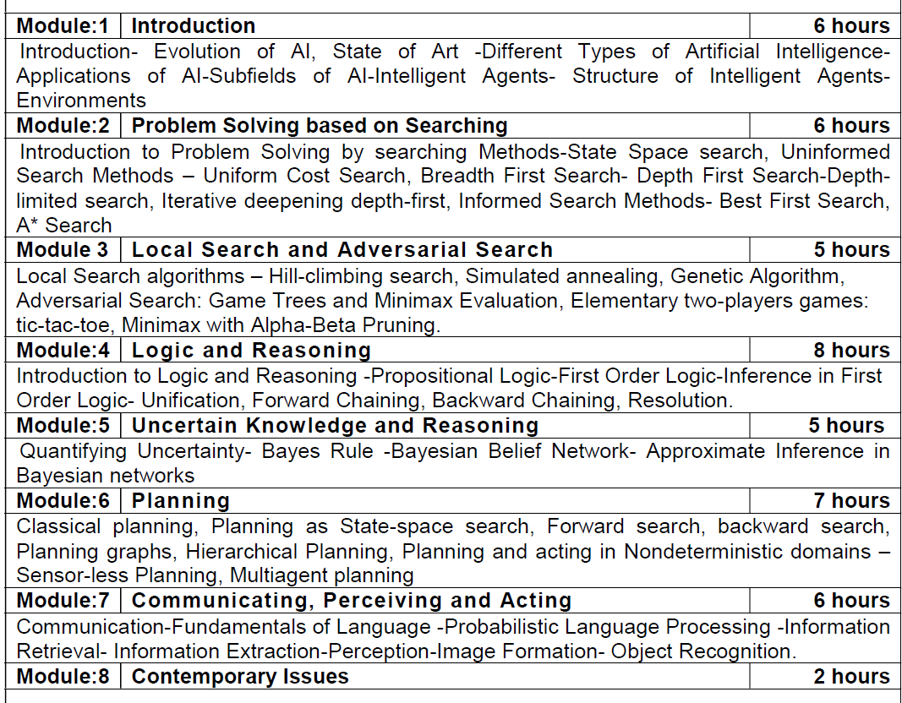
Syllabus
Unit I INTRODUCTION
Definitions - History - Intelligent Agents - Structure-Environment - Basic Problem
Solving Agents- Formulating -Search Strategies - Intelligent search - Game playing as search.
Unit II KNOWLEDGE BASED AGENTS
Representation - Logic-First order logic - Reflex Agent - Building a knowledge Base -General Ontology -Inference - Logical Recovery.
Unit III PLANNING AGENTS
Situational Calculus - Representation of Planning - Partial order Planning- Practical Planners – Conditional Planning - Replanning Agents.
Unit IV AGENTS AND UNCERTAINITY
Acting under uncertainty - Probability Bayes Rule and use - Belief Networks - UtilityTheory - Decision Network- Value of Information - Decision Theoretic Agent Design.
Unit V HIGHER LEVEL AGENTS
Learning agents - General Model - Inductive Learning - Learning Decision Trees-
Reinforcement Learning -Knowledge in Learning - Communicative agents –Types of Communicating Agents- Future of AI

Slide 3
Textbook
Russell, S. and Norvig, P. 2015. Artificial Intelligence - A Modern Approach, 3rd Edition,Prentice Hall.

Slide 4
Definition
Artificial Intelligence is
Concerned with the design of intelligence in an artificial device.
The study of the computations that make it possible to perceive, reason and act.
The study and design of intelligent agents. Intelligent agents are systems which perceives its environment and takes actions so as to maximize its chances of success.

Slide 5
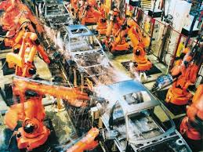
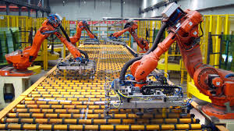
Applications of AI

Slide 6
Other applications of AI
Search engines
Robotics
Spam filtering
Automated helpdesks---Natural Language Processing
Medical diagnosis systems---Expert systems
Fraud detection
Toys and Games

Slide 7
Other Definitions
Systems that think like humans “The exciting new effort to make computers think … machine with minds, in the full and literal sense” (Haugeland 1985) | Systems that think rationally “The study of the computations that make it possible to perceive ,reason and act.” (Winston, 1992)
Systems that act like humans “The art of creating machines that perform functions that require intelligence when performed by people” (Kurzweil, 1990) | Systems that act rationally “Computational Intelligence is the study of the design of intelligent agents” (Poole et al, 1998)

Slide 8
Thinking humanly
  The cognitive modeling approach
  Introspection- determine how we think
  Predict and test behavior of human subjects
  Image the brain, examine neurological data
The latter two methodologies are the domains of cognitive science and cognitive neuroscience

Slide 9

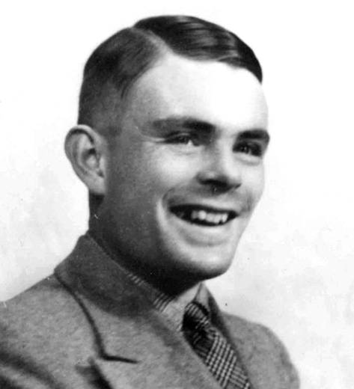
Acting humanly

Slide 10
What would a computer need to pass the Turing test?
Natural language processing: to communicate with examiner.
Knowledge representation: to store and retrieve information provided before or during interrogation.
Automated reasoning: to use the stored information to answer questions and to draw new conclusions.
Machine learning: to adapt to new circumstances and to detect and extrapolate patterns.

Slide 11
Vision (for Total Turing test): to recognize the examiner’s actions and various objects presented by the examiner.
Motor control (total test): to act upon objects as requested.
Other senses (total test): such as audition, smell, touch, etc.

Slide 12
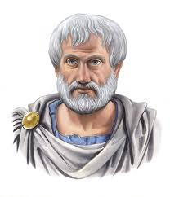
Thinking Rationally
Logic– Analytical theory of the art of reasoning
Aristotle—Father of Logic (384-322 B.C.)
Patterns of argument that always yield
correct conclusions when supplied with
correct premises
  “Socrates is a man;
  All men are mortal;
  Therefore Socrates is mortal.”

Slide 13
Thinking Rationally: Laws of Thought
Problems:
  Uncertainty: Not all facts are certain (e.g., the flight might be delayed).
  Resource limitations:
    Not enough time to compute/process
    Insufficient memory/disk/etc

Slide 14
Acting Rationally
Rational behavior: Doing the right thing!
The right thing: That which is expected to maximize the expected return
Provides the most general view of AI because it includes:
  Correct inference (“Laws of thought”)
  Uncertainty handling
  Resource limitation considerations (e.g., reflex vs. deliberation)
  Cognitive skills (NLP, AR, knowledge representation, ML, etc.)
Advantages:
  More general
  Its goal of rationality is well defined

Slide 15
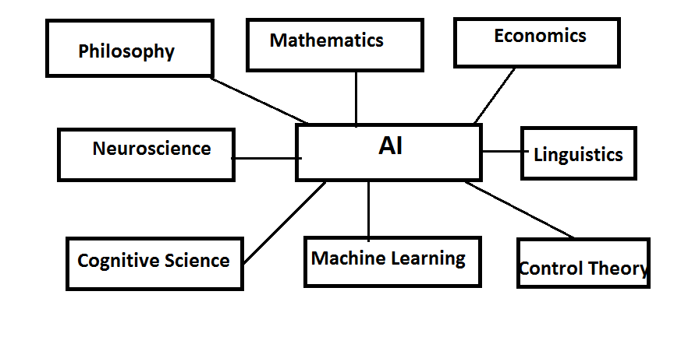
Foundations of AI

Slide 16
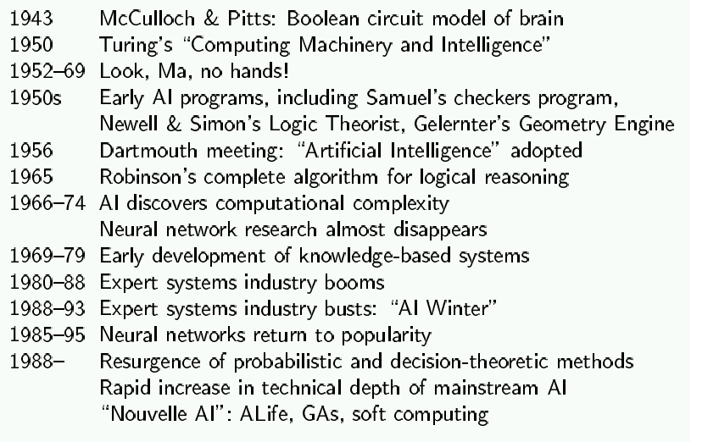
History of AI

Slide 17
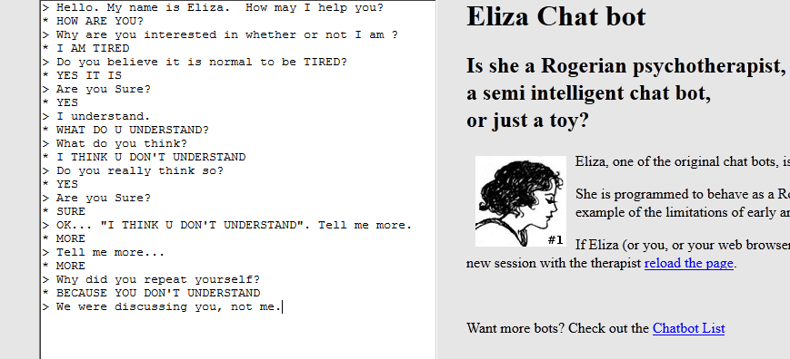
ELIZA CHATBOT
http://nlp-addiction.com/eliza/

Slide 18
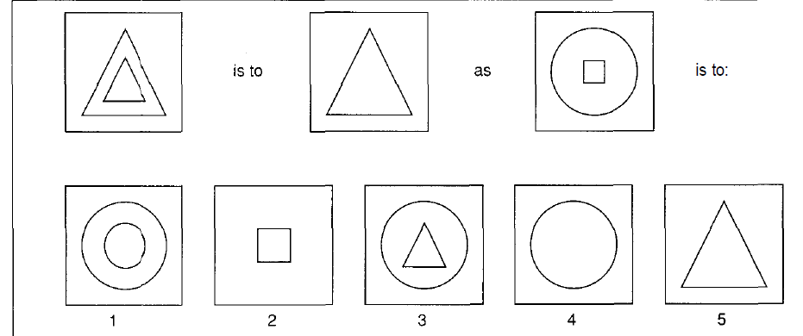
Puzzle solving

Slide 19
